Slide 1

SQL Server Performance Tuning
Simon Stride

Slide 2
Motivation
2006
Google – ½ second delay caused a 20% drop in traffic
2017
Akamai State of Online Retail Performance report 2017 found:
A 100-millisecond delay in website load time can hurt conversion rates by 7 percent
2002
Amazon identify 100ms latency results in -1% sales
Notes:
Speed Matters!!!x
Credit:
Amazon – 100ms latency = -1% sales – credit uncertain
http://glinden.blogspot.com/2006/11/marissa-mayer-at-web-20.html
https://www.akamai.com/uk/en/about/news/press/2017-press/akamai-releases-spring-2017-state-of-online-retail-performance-report.jsp
Impacts customer experience….. The list goes on!

Slide 3
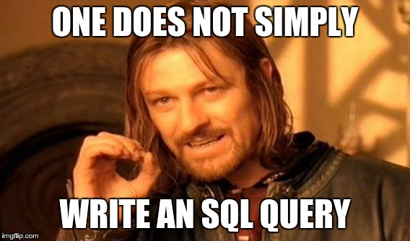
Before we start….
Notes:
Firstly, let’s be clear. Query optimisation in SQL Server is a big topic. Its truly vast.
It’s surprisingly easy to fall into traps writing bad SQL code…
There are people whose whole entire businesses revolve around improving database performance.

Slide 4
Where to start??
Dev
Query Improvement
Temp tables
DBA
Execution Plans
Query Store
DB Architect
Features - e.g. In-memory tables
Partitioning strategies
Stored Procedures
Parameter Sniffing
Index Creation
Statistic Maintenance
Business Processes
Application Layers/Tiers
Notes:
What about maintainability, conventions and clarity???? What about deployment, testing and ALM????
Today I’m going to touch on a handful of topics.
8 Simple Rules for Improving My Query

Slide 5
Rule 0 Know what you want to improve
Which part of the system needs improving?
Identify the smallest unit of a process/component of the system that it makes sense to review
Are you sure it’s the SQL code, not the application tier, ORM, network, front-end js library, API, user, driver, socket, widget or carrier pidgeon that is the slowest part of the process?
Notes:
Yes, my arrays start at 0. Don’t yours?
Before embarking on an optimisation crusade, try to 80%+ certain that it is the SQL code that is the database at fault. Improving a stored procedure by 10ms might be irrelevant in a 1 hour end-to-end process, or a multi-step task with user involvement at each step
The SQL stored proc might be only one component of something the user perceives to be slow.
Eli Goldratt – Theory of Constraints - optimising anything other than the bottleneck is WASTE

Slide 6

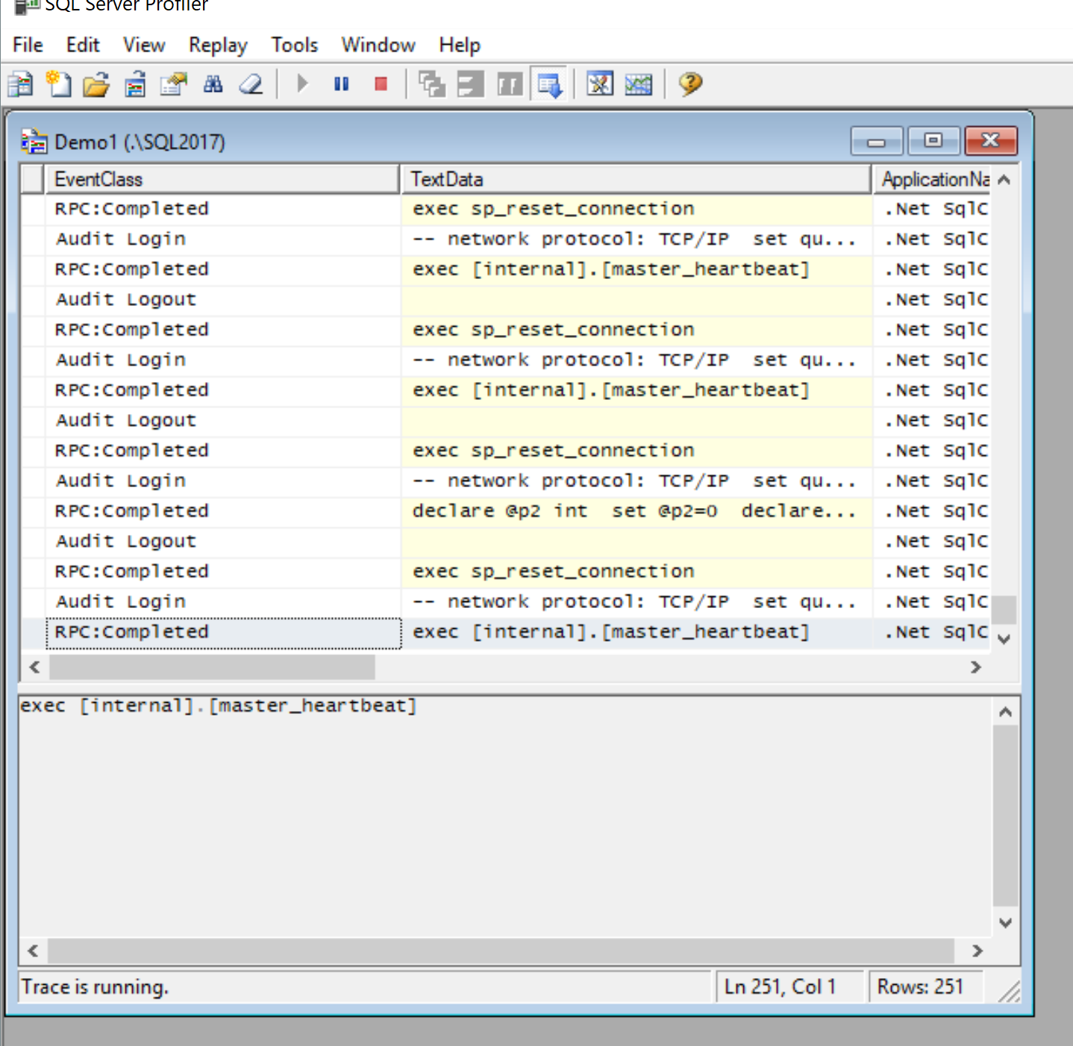
Demo – using profiler to see what’s running
SQL Server Profiler gives an idea of what is running in real time
Notes:
Profiler is a quick and easy way to see what’s running in real time

Slide 7
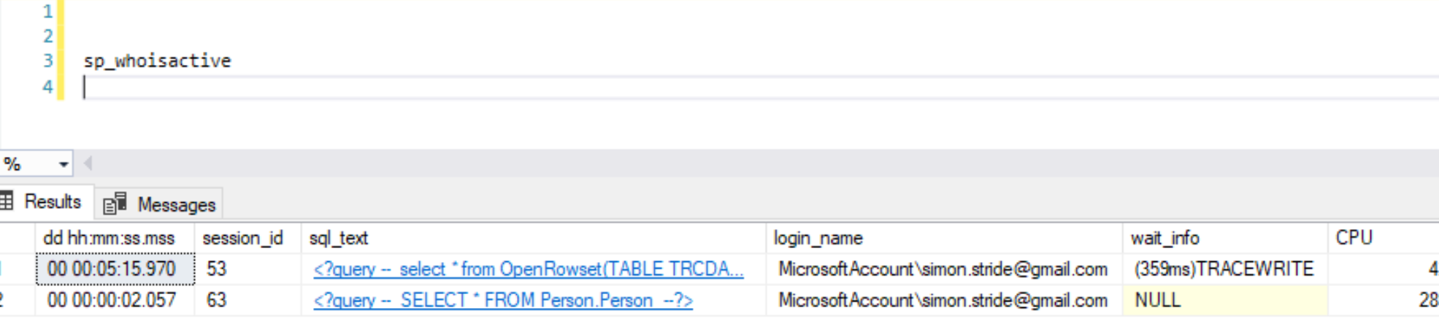
Demo sp_whoisactive
http://whoisactive.com/

Slide 8
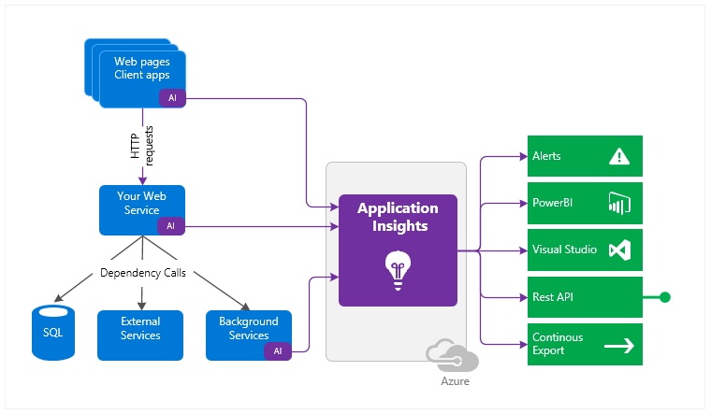
Rule 1 – How will you measure improvement?
What telemetry can you use to track your improvements?
How will you measure success?
Does this improvement tie back to business outcomes?
Notes:
Hint: success should equate to a quantifiable improvement in your production workload
Tying your work back to a business outcome will improve buy-in from your boss and demonstrate value to business folk, who don’t really care how the code works – but who will care if it improves sales, reduces costs or increases customer satisfaction.
Azure app insights - https://docs.microsoft.com/en-us/azure/azure-monitor/app/app-insights-overview

Slide 9
Rule 2 Review the architecture setup
Hardware – is the database running on old kit?
Shared Infrastructure – is the database sharing resources with “noisy neighbours”?
Software version – are you running on SQL Server 2000? Can you migrate to a newer version? Are you running the latest patches?
Application tier - is the application handling data that could be done in the database? Could your ORM queries be improved with a stored procedure?
What is the workload? OLTP or analytical? Have you optimised for ad-hoc workloads?
Notes:
Lets presume telemetry shows that the database is the longest part of the process
E.g. the database returns a whole table of data so that the application can aggregate the totals
Afterthought:
Should you be using a different database pattern e.g. reading from a mirror, BI platform, or even using queues, asynchronous patterns…. What about caches? Or should it even be in an RDBMS?

Slide 10
Rule 3 - First Do No Harm
Make sure that your changes do not break the production database
Make sure that your changes do not break the production database
Make sure you have a plan for when you do break the production database
e.g. backups are a bare minimum!
Preferably have your code in source control
No one's perfect
Try to ensure you have a sandboxed environment that adequately represents the production setup
Notes:
Ensure that any PII in tests systems is only what is specifically required for testing; where possible try not to use production data in the first place.
Test systems represent an additional liability for GDPR compliance that developers are often more responsible for than the DBAs
Ask your DBA if you need any help/advice on obfuscation strategies

Slide 11

Rule 4 Look at the SQL
Try to step through what the query is doing
Does it need to join the sales order table to get the customer surname?
Are there steps that could be done set-wise rather than in loops?
Notes:
Some queries are just plain… yan
It’s entirely possible that the query is as simple as can be – but the table is too wide, or has too many clobs. Apply some design to the data structures of your database – 3rd normal form works best for SQL Server.
Admittedly, sometimes SQL Server isn’t the best fit for all use cases (back to previous Rule 3)
Use the execution plan to help you… but don’t trust everything you read!!!

Slide 12
Rule 5
If the query is as simple as it can possibly be, or you have limited sway over the code/architecture/application, then look at indexing!
SQL Server can give you a hint:
select *
from sys.dm_db_missing_index_details
Brent Ozar can give you a hint too:
sp_BlitzIndex®
Notes:
https://docs.microsoft.com/en-us/sql/relational-databases/system-dynamic-management-views/sys-dm-db-missing-index-details-transact-sql?view=sql-server-2017
https://www.brentozar.com/blitzindex/

Slide 13
Traditional Rowstore Indexes
Indexes contain an ordered list of where data is stored on disk
This enables the database engine to retrieve specific data more efficiently
Indexes come in two shapes – Clustered or Nonclustered
Clustered Indexes impact the order in which the data is physically stored on disk
Non clustered indexes do not direct impact the storage order
Notes:
Up to 999 indexes per table in SQL 2012

Slide 14
Index Gotchas
Indexes take up space in addition to the table data
Indexes add maintenance overheads and can become out of date on busy systems
Sometimes one well-thought-out index can replace lots of smaller indexes
Just because an index exists doesn’t mean its used…
Notes:
It’s entirely possible for the index space to exceed the table space if you keep adding an index for every possible scenario

Slide 15

Demo
Adding an index…

Slide 16
Columnstore Indexes for Analytics
Columnstore indexes are a good fit for bigger tables (1,000,000+ rows)
Data is stored column-wise, meaning that columns with lots of repeated values can be compressed dramatically
Less storage, less data transferred on queries
For more info…
http://www.nikoport.com/category/columnstore/

Slide 17
Rule 6 Document and test your changes before deploying
If you later find out you got it wrong….
Or you need a vendor to replicate your findings…
Or you’re contributing to an open source projects…
Or you now have a custom proc/view/table that no longer exists in the vanilla install…How will you deal with that?
Source Control your database and any changes!!

Slide 18
Rule 7 – Review the impact of your changes
Check that your performance improvement has a comparable improvement in production
Is there anywhere else you can reapply your new-found performance enhancements?
What’s the next performance bottleneck to work on?
Notes:
Aka the 8th and final rule

Slide 19
Afterthought
No-one sets out to write bad queries!
Chances are the author did the best they could with the information they had available under the specific circumstances that surrounded the work – time, resource, skills, deadlines…
Leave the campsite cleaner than you found it – more comments, neater code, and preferable better documentation!
“Add another index” might not be the best solution to poor performance – use the right tool for the job
Notes:
Empathy for your fellow devs is important

Slide 20

Questions?

Slide 21
Resources
https://www.brentozar.com/first-aid/
http://whoisactive.com/
https://www.sentryone.com/plan-explorer
https://www.sqlskills.com/blogs/paul/wait-statistics-or-please-tell-me-where-it-hurts/
https://www.brentozar.com/sql/watch-brent-tune-queries/
https://docs.microsoft.com/en-us/azure/azure-monitor/app/app-insights-overview
https://www.mssqltips.com/sqlservertip/3559/how-to-grant-permissions-to-run-sql-server-profiler-for-a-non-system-admin-user/

